Slide 1
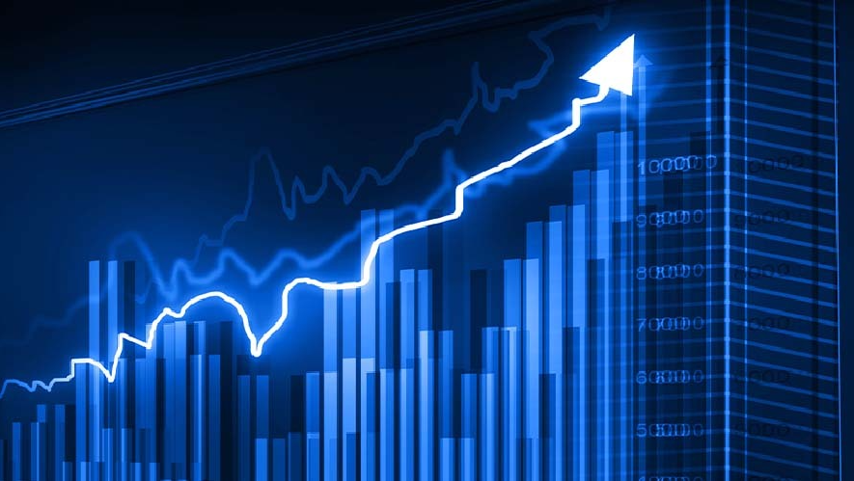
GROUP - 3
INFO 5082
Aruna Pudhota - 11607341
Inamul Jannath Hussain Shaik - 11609321
Manasa Cherukupally - 11604712
UdayKiran Reddy Kotha – 11608672 Sai Krishna Patha – 11546559
Satish Chandra Kasulanati - 11552186

Slide 2

STOCK PRICE PREDICTION OF FAANG COMPANIES USING A FINE TUNED LLM MODEL AND PROMPT ENGINEERING
This study focuses on predicting FAANG stock prices by leveraging a refined language model (LLM) and prompt engineering. It aims to develop a reliable forecasting tool by optimizing these models with historical data and external factors.

Slide 3

AGENDA
Title
Motivation
Background
Abstract(Problem statement)
Literature Survey
Objectives of the Study
Data Set and Data Processing
Research Design(Blueprint/Workflow)
Data Analysis and Model Description
Data Visualization and Results
Conclusion
References

Slide 4
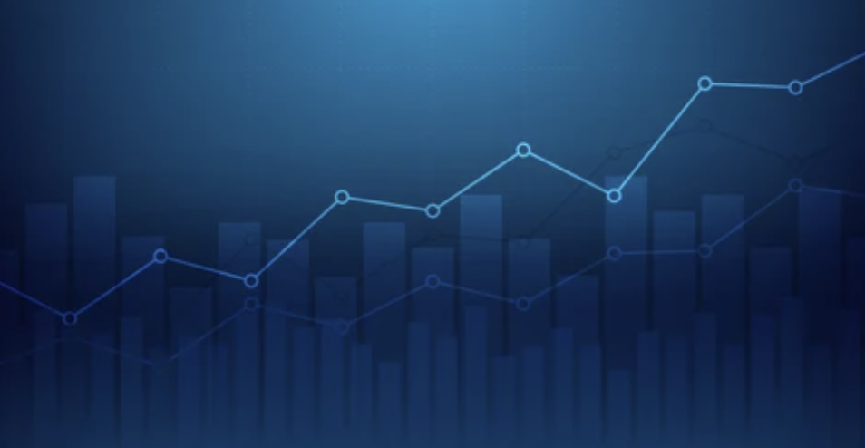
MOTIVATION
Large Language Models (LLMs) and innovative prompt engineering techniques is a driving force behind our project.
Our motivation lies in developing a tool that goes beyond traditional forecasting methods.
By optimizing LLMs through fine-tuning and prompt engineering, we aim to create a robust system that empowers decision-makers with accurate and timely insights into FAANG stock prices.
Our aim is not just predicting prices but also leveraging these technologies.

Slide 5
BACKGROUND
Our project originates from the evolving landscape of financial forecasting, where traditional methods often struggle to capture the complexity of stock market dynamics.
Leveraging the emergence of Large Language Models (LLMs) and innovative prompt engineering techniques this endeavor aims to reimagine stock price prediction, specifically focusing on FAANG (Facebook, Apple, Amazon, Netflix, Google) stocks.
The motivation lies in harnessing these cutting-edge technologies to fine-tune LLMs for regression tasks and craft effective prompts that incorporate historical data.
The goal is to develop a robust forecasting system that empowers traders and investors with reliable insights, aiding informed decision-making in the volatile financial realm.

Slide 6
ABSTRACT (PROBLEM STATEMENT)
This research project explores the application of advanced language models, specifically Large Language Models (LLMs), in predicting stock prices for FAANG companies (Facebook, Apple, Amazon, Netflix, Google).
Traditional approaches have difficulty capturing subtleties and external influences. This research optimizes Large Language Models (LLMs) such as GPT-2 for regression, with the goal of predicting individual stock closing prices.
The challenge is to provide effective input prompts while also incorporating important data, technological indications, and external influences. The project's primary objective is to develop a robust and reliable forecasting system that empowers traders and investors with accurate insights into stock price movements.
The project's findings aim to bridge the gap between cutting-edge AI capabilities and practical applications in finance. Enabling more informed decision-making in dynamic and rapidly changing financial markets.

Slide 7
LITERATURE REVIEW
The literature review encompasses pertinent studies on Large Language Models (LLMs) and prompt engineering techniques.
Addlesee et al. (2023) highlighted prompt engineering's relevance in optimizing LLMs, crucial for stock price forecasting. Schacht et al. (2023) emphasized information extraction through prompt engineering and LLMs, aligning with the project's goal.
Lim and Schmälzle (2023) showcased prompt engineering's impact on content generation, offering insights adaptable to refining prompts for stock prediction. Steinert and Altmann (2023) illustrated LLMs' application in analyzing sentiment's influence on stock movements.
These studies collectively underscore the significance of prompt engineering and LLMs' adaptability, providing a foundational framework for this project in enhancing stock price predictions.

Slide 8
OBJECTIVE OF STUDY
Dataset research of stock prices of Facebook, Amazon, Apple, Netflix, Google datasets
Loading of the datasets (Facebook, Apple, Amazon, Netflix, Google)
Merging of the five datasets in to a final FAANG dataset
Data pre-processing (exploring dataset, removing outliers, feature engineering, dropping variables, creating dummies, dropping missing values)
Exploratory data analysis (visualizations)
Data splitting

Slide 9
OBJECTIVE OF STUDY
Train and test split of the dataset
Initializing and training models (linear regression,
xgboosting regressor)
Predicting test data using training model
Evaluation metrics
Loading pre-trained LLM models and tokenizers
Creating prompts for inputs using prompt engineering techniques
Generating output prompt along with predicted values for the given input prompts using trained models.

Slide 10
DATASET AND DATA PRE-PROCESSING
We have five different datasets of stock prices like Facebook, Amazon, Apple, Netflix, Google.
All five dataset has 1761 rows and 7 columns consists of fields like date, open, high, low, close, adj close and volume for each company.
Creating company column for each dataset with its company name.
Now merging all 5 different datasets in to one final dataset named as FAANG dataset.
Exploring the dataset
Removing outliers in the volume column as identified in the box plots.
Performing visualizations to understand the variable distribution, counts and the correlation with respect to the target variable

Slide 11
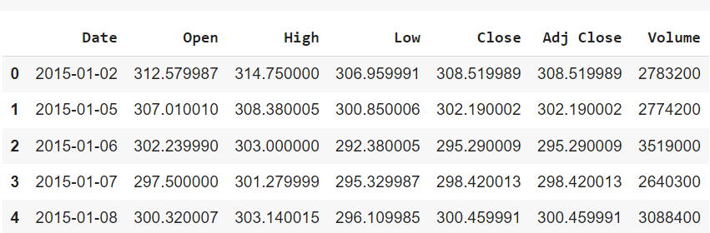
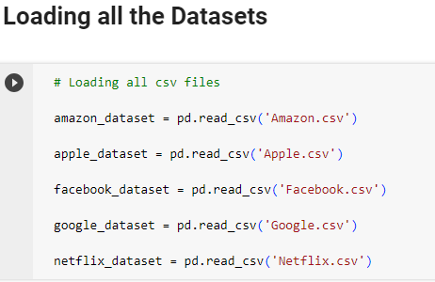
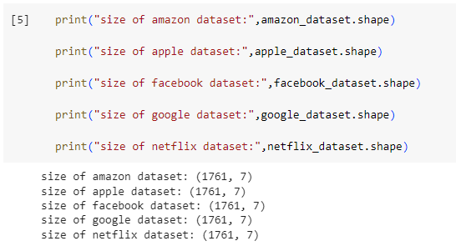
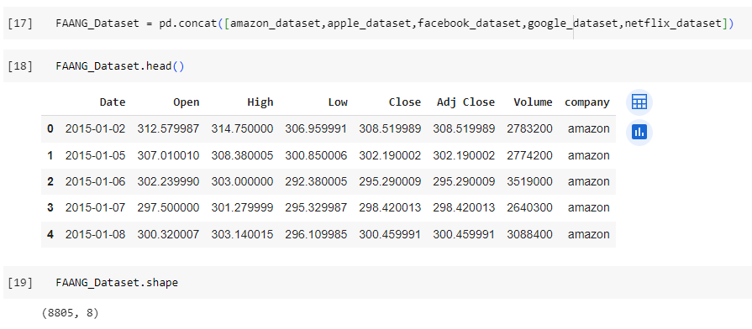
LOADING DATASETS
FAANG DATASET

Slide 12
RESEARCH DESIGN (WORKFLOW DIAGRAM)
DATASET PRE-PROCESSING
MERGING MAIN DATASET
EXPLORATORY DATA ANALYSIS
TRAINING AND TESTING SPLIT
LOADING AND TRAINING MACHINE LEARNING MODELS
EVALUATION METRICS
LOADING AND SAVING LLM MODEL
CREATING PROMPTS
LOADING LLM MODEL WITH PROMPTS AND PROVIDING THE TUNED MODEL FOR PREDICTION
WITH THE PREDICTED MODEL TO SHOW THE OUTPUT PROMPT ALONG WITH THE PREDICTED OUTPUT.
LOADING OF THE DATASET
RESEARCH OF THE DATASET

Slide 13
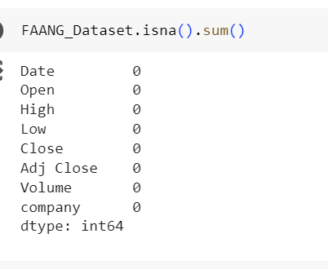
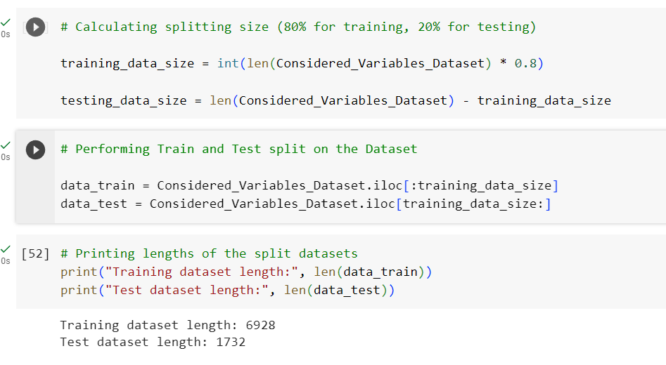
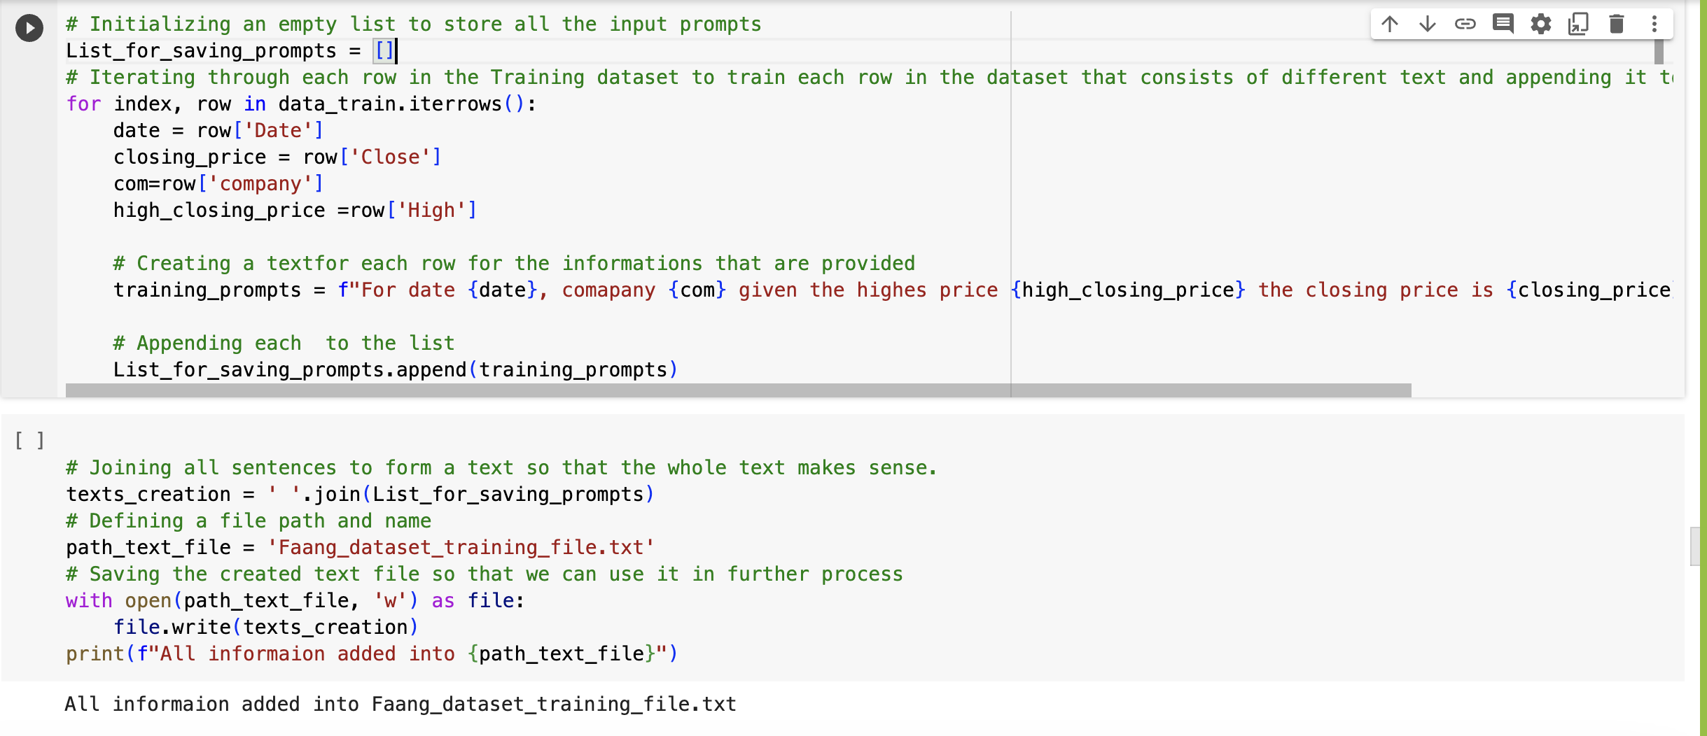
DATA ANALYSIS AND MODEL DESCRIPTION

Slide 14
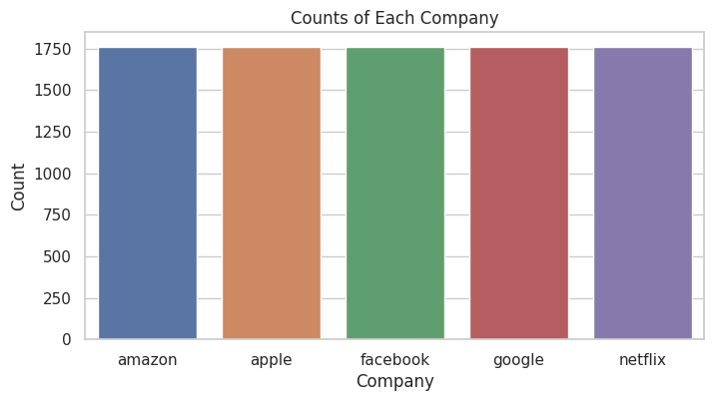
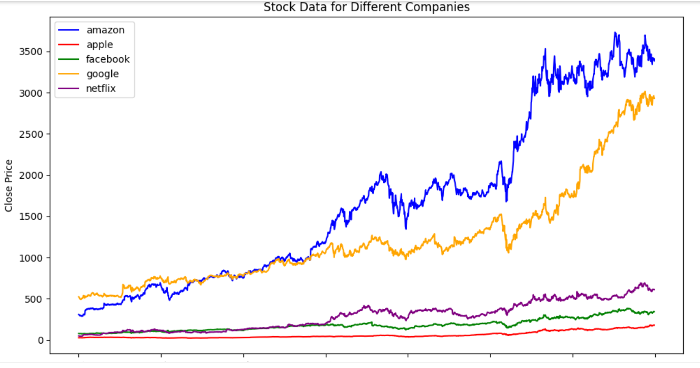
DATA VISUALIZATION
Stock Count of Each Company
Trend Analysis over years of stock closed price for FAANG Companies

Slide 15
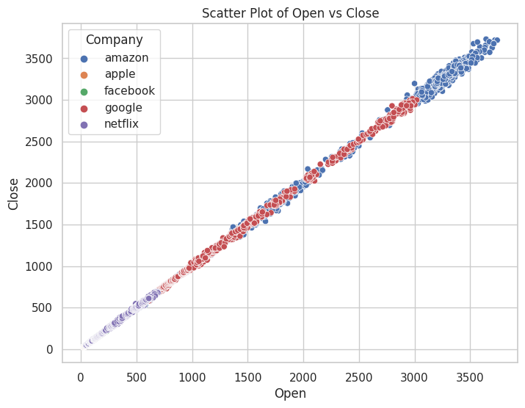
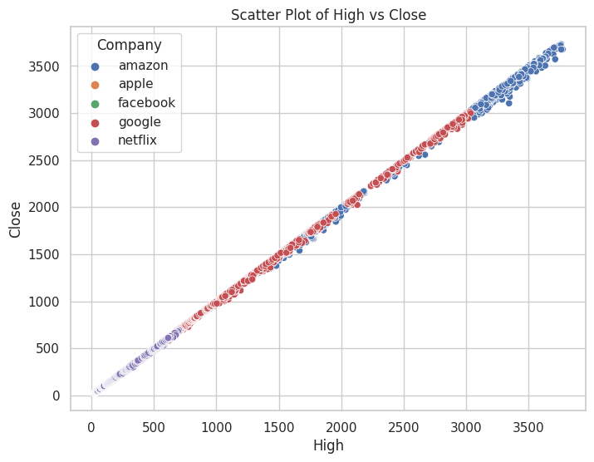
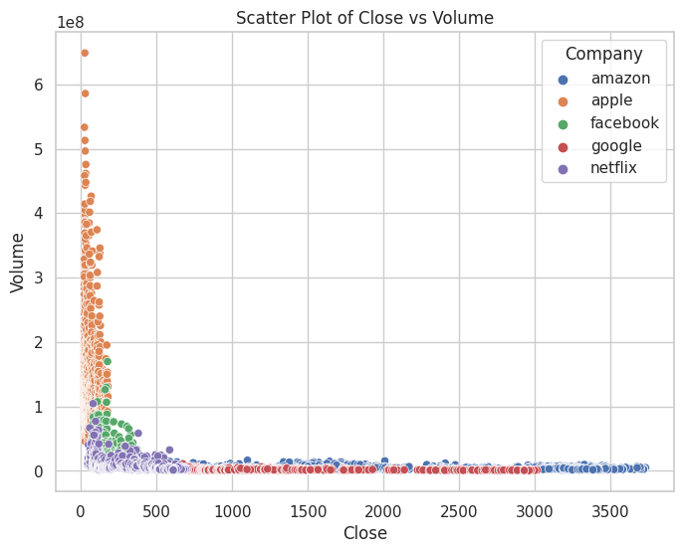
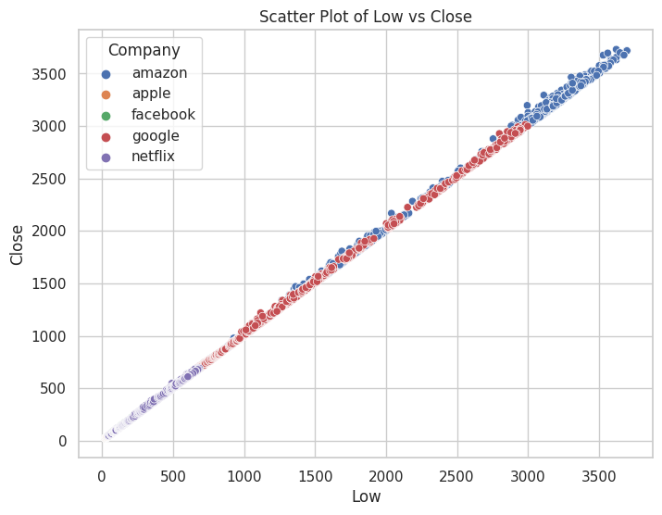
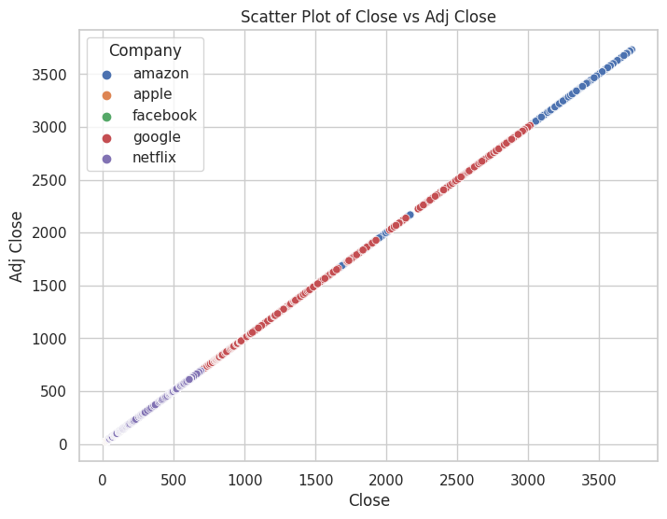
DATA VISUALIZATION

Slide 16
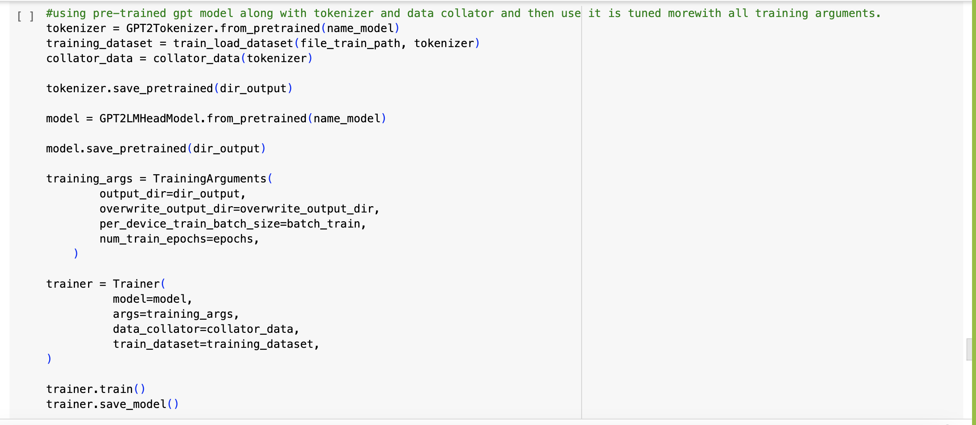
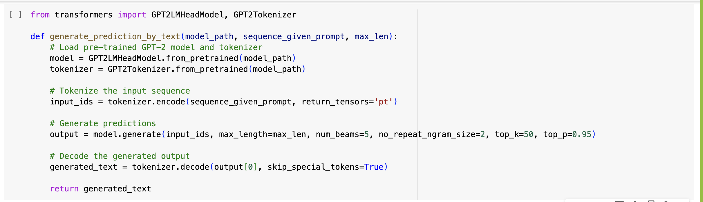
GPT MODEL
Initializing a GPT-2 language model from the pre-trained 'gpt2' model checkpoint. This model is taken from the Hugging Face Transformers library.
Implementing the GPT Model

Slide 17
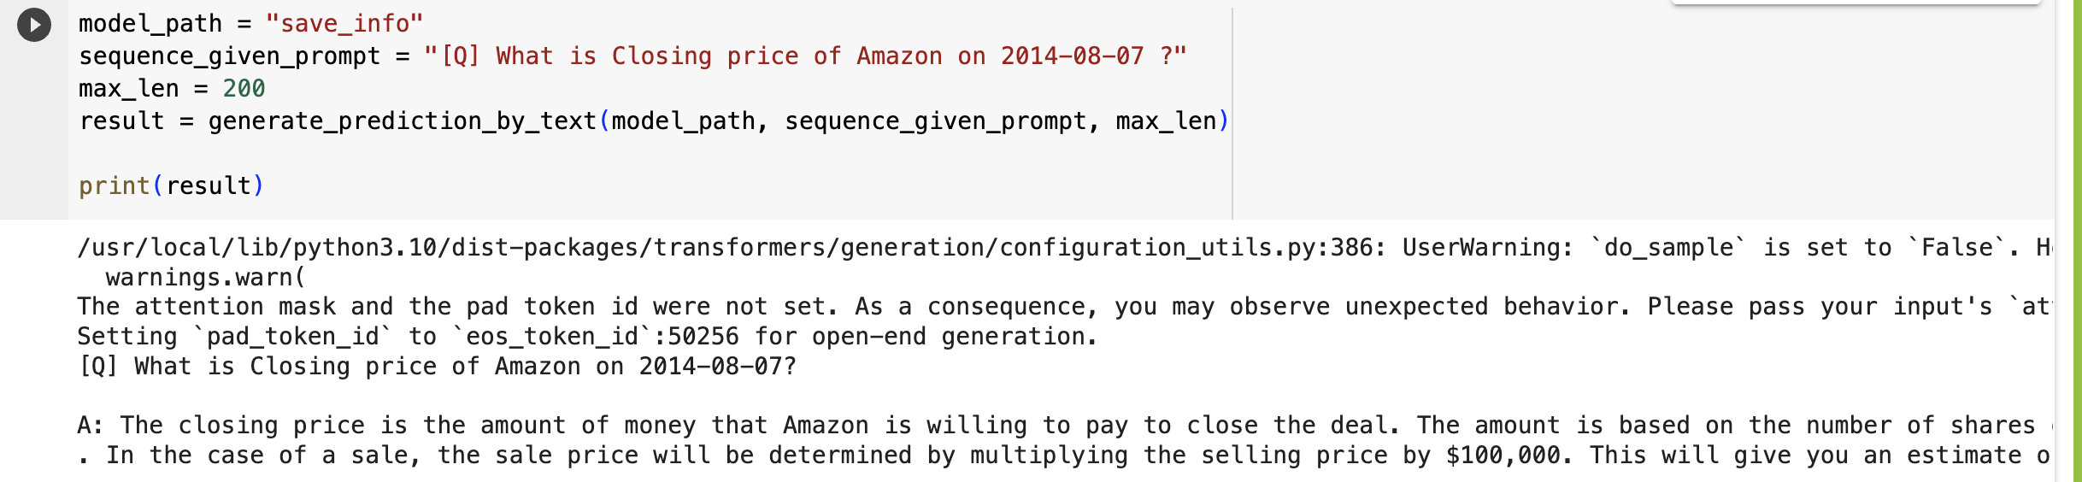
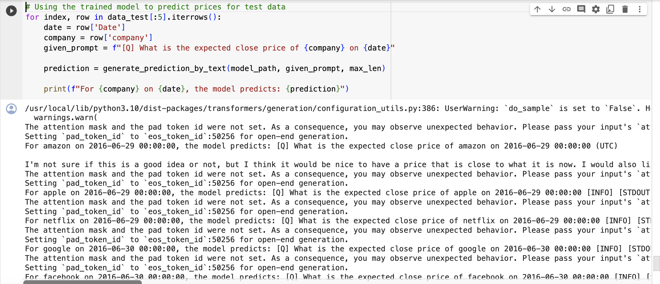
GPT MODEL OUTPUT - RESULTS

Slide 18
CONCLUSION
Our model Stock price prediction have shown encouraging results from the application of Large Language Models (LLMs), such as GPT-2.
Built with natural language processing in mind, these models have demonstrated their capacity to interpret complex relationships and patterns found in financial data.
To improve the accuracy and reliability of models, strong validation methods, and domain knowledge remain essential.

Slide 19
REFERENCES
Brand, J., Israeli, A., & Ngwe, D. (2023). Using gpt for market research. Available at SSRN 4395751.
Wei, F., & Nguyen, U. T. (2018). Stock trend prediction using financial market news and BERT. Wall Street Journal.
Cholakov, R., & Kolev, T. (2021). Transformers predicting the future. Applying attention in next-frame and time series forecasting. arXiv preprint arXiv:2108.08224.
Cao, D., Jia, F., Arik, S. O., Pfister, T., Zheng, Y., Ye, W., & Liu, Y. (2023). TEMPO: Prompt-based Generative Pre-trained Transformer for Time Series Forecasting. arXiv preprint arXiv:2310.04948.

Slide 20
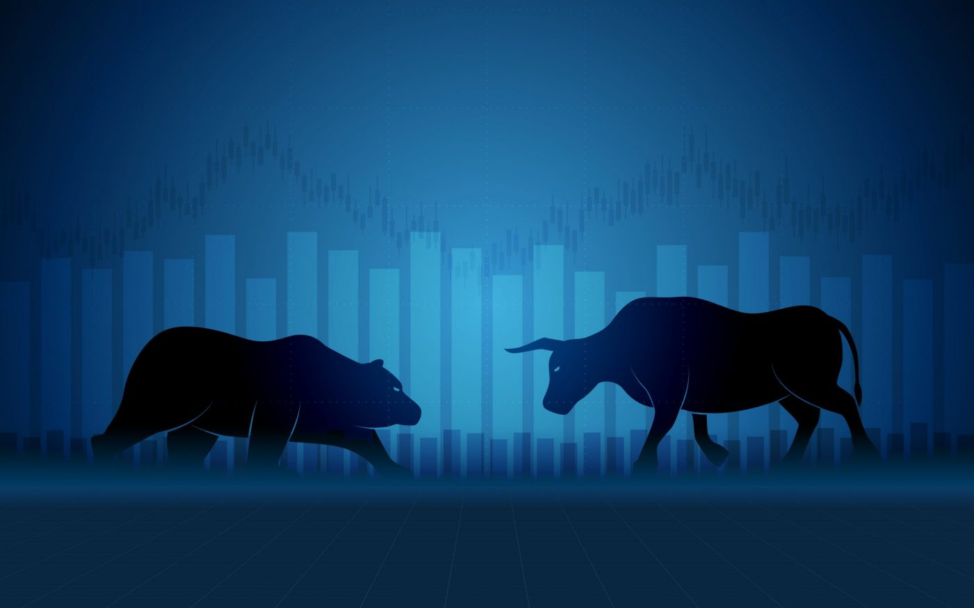

GROUP- 3
THANK YOU

